Slide 1
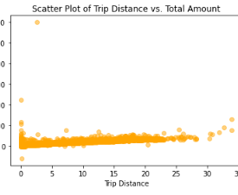
Analysis of NYC Taxi Trip Data
Title
Subtitle
Unveiling Patterns and Trends in TLC Dataset
Project Overview
Understanding taxi trip data is crucial for enhancing transportation services and enabling informed decision-making. By delving into dataset, we can uncover valuable insights that drive improvements in service quality, operational efficiency, and customer satisfaction.
Trip Characteristics: Exploration of trip_distance and total_amount unveiled crucial patterns in taxi ride lengths and fare amounts, essential for fare estimation and service optimization.
Payment Trends: Analysis of payment types revealed the prevalence of credit card payments and associated tip amounts, offering insights into customer preferences and payment behaviors.
Passenger Counts: Examination of passenger counts provided valuable insights into ride-sharing behaviors and service demand, facilitating resource allocation and service planning.
Data Quality Issues: Identification of anomalies like negative total_amount values underscores the importance of rigorous data cleaning and validation processes to ensure data accuracy.
Image Alt-Text Here
Data Cleaning: Ensure data quality by addressing anomalies and inconsistencies.
Advanced Analysis: Explore correlations and conduct predictive modelling.
Enhanced Visualization: Create visuals for effective communication.
Stakeholder Engagement: Collaborate to refine project objectives.

